Slide 1
Lee SungHo
16102284
0
Supply Chain Management
M.S Son
Cpt. Korea
Need girl 1
Y.H Kim
Dark Templar
Need girl 2
W.S Choi
Commando
Need girl3

Slide 2
Index
0
Target company
Motivation
Project Plan

Slide 3

Target company
1
As of May 20, company succeeded in attracting a total of 222.8 billion won in investment and was registered as a unicorn company.
According to data released by ‘WiseApp’, sales increased 126% from last year due to COVID-19.
Competitors include ‘Coupang(로켓 프레쉬)’, ‘Shinsegae(SSG)' and ‘Lotte(새벽에 ON)'.
<Market Kurly>

Slide 4
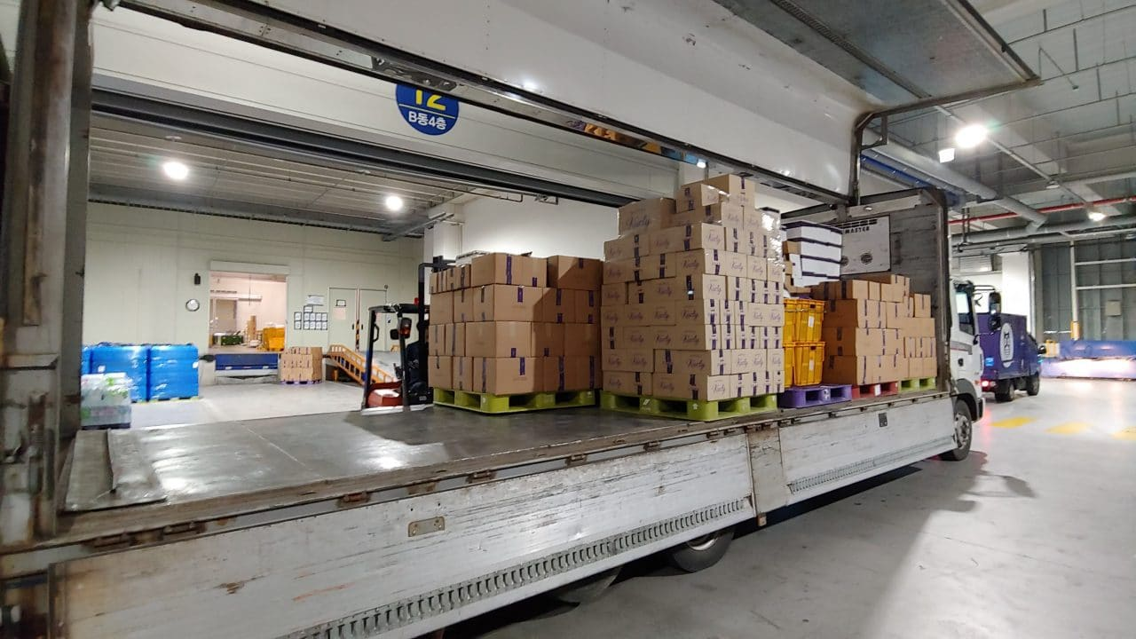
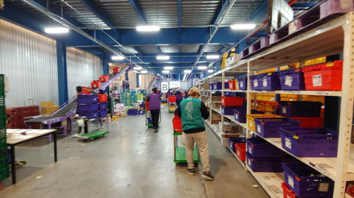
Target company
1
Delivery service early the next day for orders prior to 23:00, called ‘샛별 배송' (limited to metropolitan areas)
Total area: 10,000 pyeong
Daily shipments: 20,000 to 40,000 units
The number of workers working a day: up to 600, all personnel outsourcing.
The number of daily deliverymen: 100 directly managed by Market Kurly, up to 600 registered.
The Picking Automation System is based on the Digital Assorting System (DAS) Unlike other competitors, (DPS).
<Receiving and Inspection>
<Picking>

Slide 5
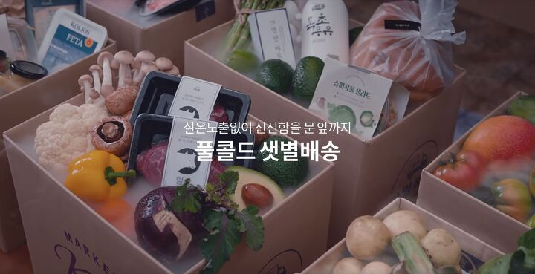
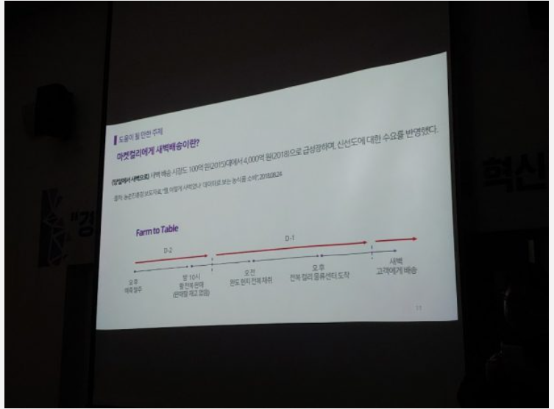
Target company
1
Delivery service early the next day for orders prior to 23:00, called ‘샛별 배송' (limited to metropolitan areas)
Quality-first policy with high overall price of products sold (first full cold chain technology introduced in the industry)
Quality-first policy with high overall price of products sold (first full cold chain technology introduced in the industry)
Using a data machine learning-based automatic ordering program, the company anticipates and orders customer orders even before production begins, and receives customer orders without inventory. Through this rigid ERP system, the 1% commodity disposal rate was recorded.

Slide 6
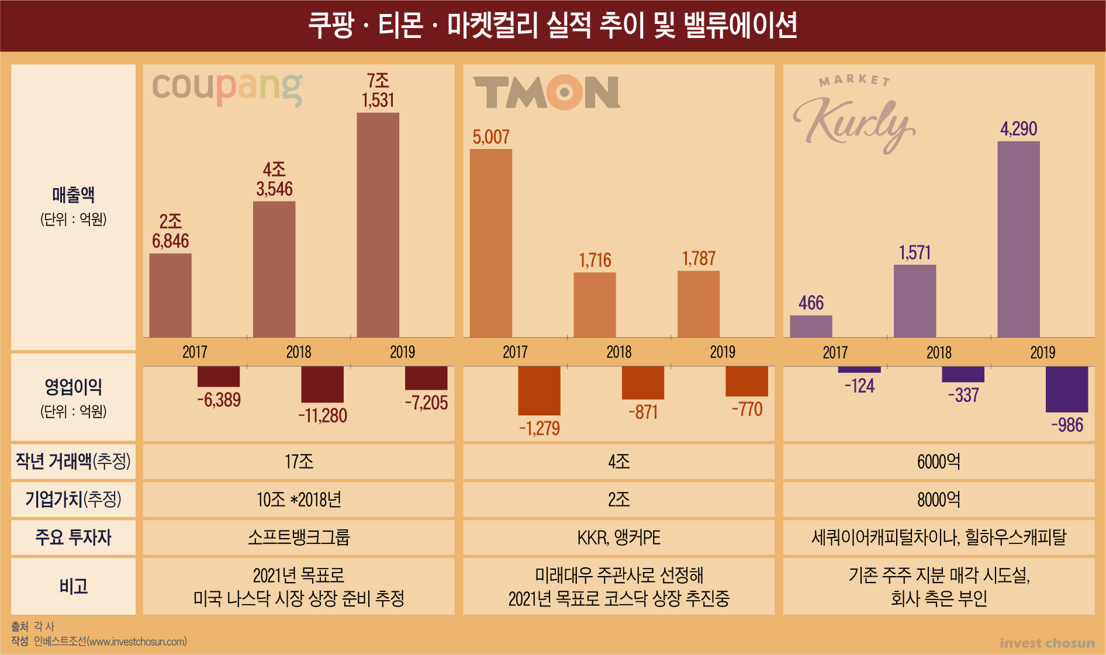
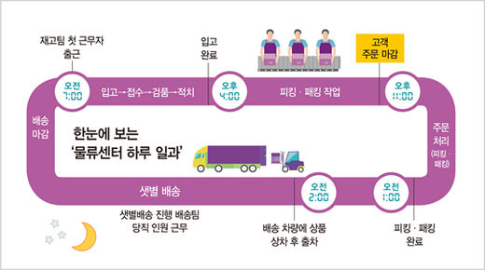
Motivation
2
As in the graph on the side, profits are rapidly increasing, but operating profits are growing in the red.
There is no cash cow
(Ex: Amazon Web service on Amazon)
It is not easy to grow as retail giants such as “Shinsegae" and “Lotte" have launched similar services in the e-commerce market one after another.
The conveyor belt is not efficient because the logistics are concentrated at a certain time (7-11 o'clock).
It's early morning delivery, so the overtime pay(야근수당) is high.
Securing logistics warehouses is not easy & logistics companies(‘팀 프레시’) account for a large portion

Slide 7
Project Plan
3
Create a new fresh food hub center in conjunction with the local supermarket
: As Amazon acquired ‘WholeFood' to establish a foothold in fresh food delivery, ‘Marketcurly’ will unite with 20,000 local supermarkets nationwide in the 42 trillion market to foster the power to resist large companies
=>By strengthening the interface with the 3PL company (local supermarket) operating system and its system, the company prepares items to be received and shipped in advance during the day by predicting data that was normally sold in the region. In addition, joint purchases with companies can reduce operating costs by lowering the unit price of goods.

Slide 8
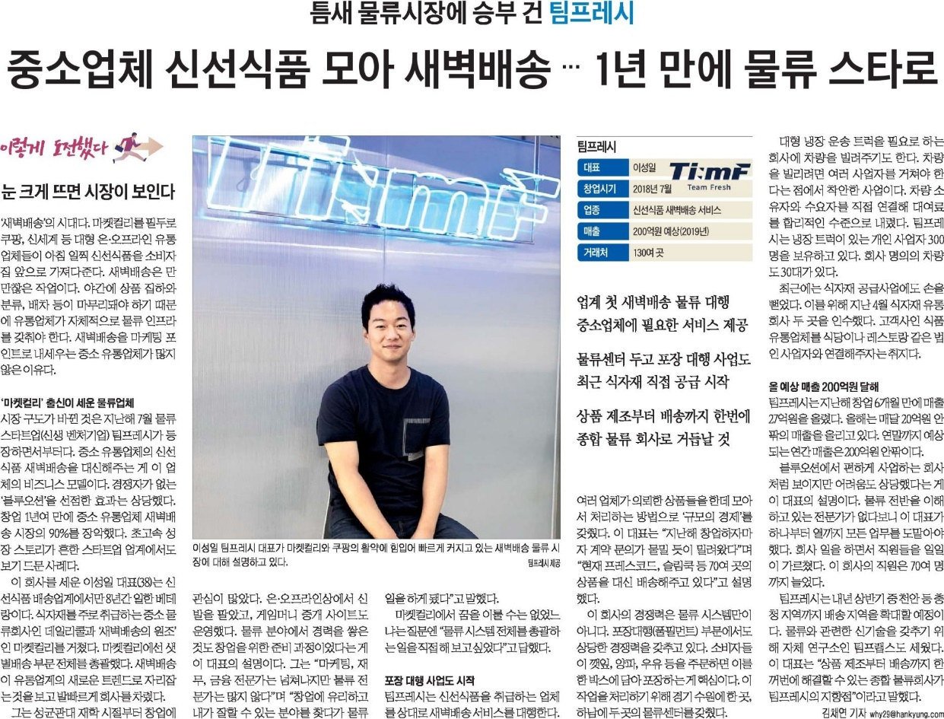
Project Plan
3
2. Company need to get out of our heavy reliance on ‘팀 프레시’ company
: ‘팀 프레시’ is responsible for much of Market Kurly's fresh food delivery, so much of Market Kurly's success know-how, except for ideas such as product composition, is focused on ‘ 팀 프레시’. Although the CEO is from the company, he is now in a friendly relationship, it is necessary to internalize the cold chain full-filament system as ‘Market Kurly’ will have a significant target when the competitor takes over the company.

Slide 9
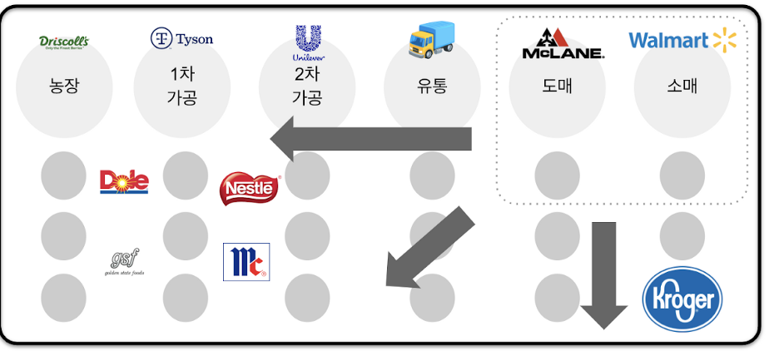
Project Plan
3
3. Introduction of Supply Chain System Using Blockchain
: In order to further refine the demand forecasting system, which is currently being used well, the company introduces block chain technology to secure high-quality data, increasing the inflow of systems from franchises and increasing the missing data.
=> This makes it easy for farmers and small and medium-sized enterprises with poor ERP systems to enter company ERPs.
<Example of WallMart’s SC using block chain>

Slide 10
https://ilyo.co.kr/?ac=article_view&entry_id=338697 http://fpost.co.kr/board/bbs/board.php?bo_table=fsp2&wr_id=11 https://magazine.hankyung.com/business/article/2019041501220000171 https://logipress.tistory.com/662 http://www.investchosun.com/2019/06/25/3238669 https://byline.network/2019/09/23-59/
Reference
4

